Slide 1


DOCTOR’S OFFICE
Alejandro Cabral, Michael Chau Jon Heikkinen, Alen Peter

Slide 2

Overview
This project is a desktop application that will make it easier for doctors and patients to view and schedule appointments. Doctors can view their schedule and patient information and patients will be able to see/schedule appointments.

Slide 3
Registration
All patients and medical staff need to have an account to use doctor’s office portal.
Doctors are pre-registered and therefore the registration page in this portal is exclusively for patients to provide their information and create an account.
All the information filled in the registration form is sent to the database for storage.

Slide 4

Doctor
When a doctor logins to the page, the program identifies it and directs to the medical staff’s page.
Once logged in, doctors will be able to view their agenda and view patient information

Slide 5

Patient
When a patient logins to the page, the program identifies it and directs to the patient page.
Once logged in, patients will be able to view upcoming appointments, book/cancel appointments, find doctors based on location and view hospital locations

Slide 6
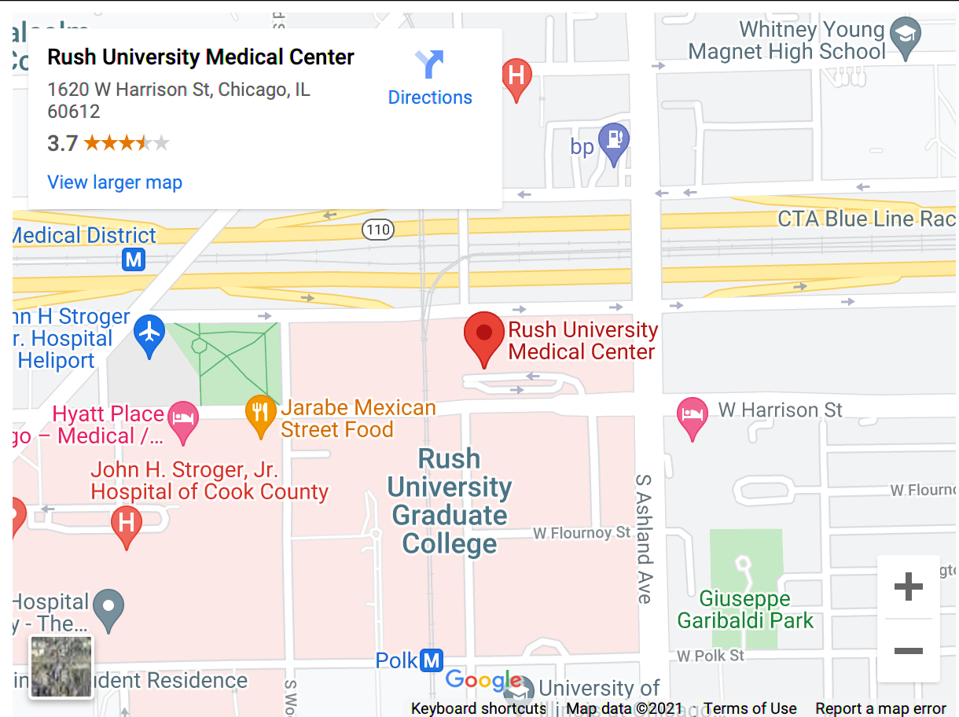
Map
Google API embedded map integrated into application
Patients can see the location of their appointment within the map.
Patients can also view which doctors are located at which hospitals from map view

Slide 7
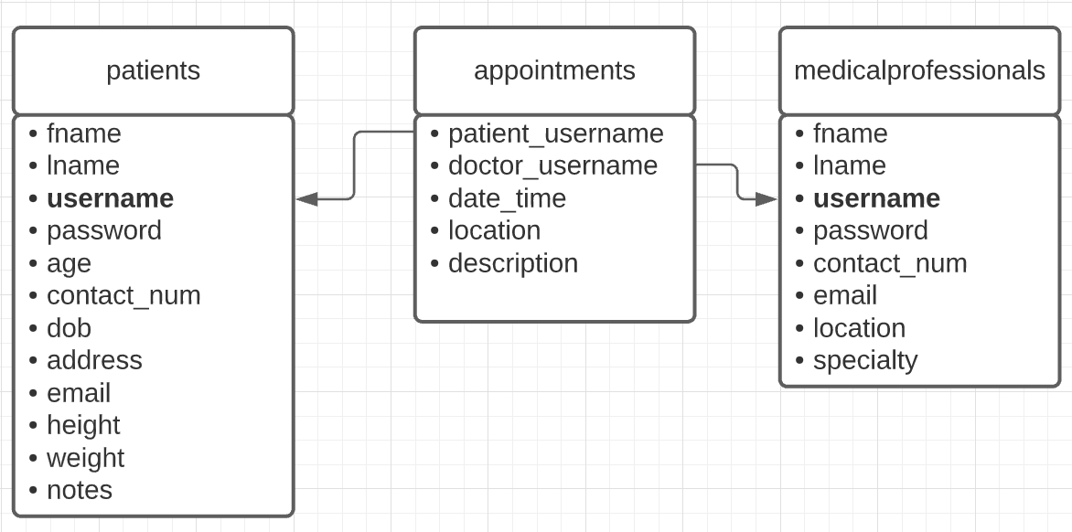
Database
The program stores information on a MYSQL database which contains three tables. They are patients, medical professionals and appointments.
The information stored in the database is pulled up by the program to display information relating to a doctor, patient or both.

